Slide 1
Security System using Cryptography, Steganography and Watermarking
Submitted By: Guide Name:
Sayed Shazeb Prof. Mayank Sohani
Rahul Gangwal
Shubhra Chaturvedi
Anant Chaudhary

Slide 2
Contents
Objective
Problem Definition
Proposed Solution
System Architecture
System Design
System Implementation
Conclusion
Future Work
References

Slide 3
Objective
The aim of our project is to create a powerful tool which is used to keep information secure and increase the level of security for key information.
Cryptography scrambles information so that it cannot be understood. Steganography attempts to prevent suspecting the existing of data by unintended recipient. Digital image watermarking provides copyright protections by hiding rightful information for declaring ownership.

Slide 4
Problem Definition
Problem statement describes the following problems:
There are various important information which is exchanged via network. Various intruder or attacker tries to intrude into your system. If your information is not secret then attacker keep your private information and misuse them by modifying it i.e. loss of integrity .
Information gets compromised when information is accessed by intruder i.e. loss of confidentiality.
Suppose that A wants to send message to B ,when A sends the message to the network suppose an intruder takes a hold of a message and presents to B as if he is legitimate sender of the message, so intruder is unauthorized sender of a message.

Slide 5
Proposed Solution
The proposed solution is to make a single application that will provide three layer of security for the user data.
Encrypt/Decrypt data using cryptography to address the loss of confidentiality.
Hide the data behind image, audio etc to provide additional layer of security.
Watermark an image using watermarking to address the problem of unauthorized sender of a message.
User interface will be having three checkboxes for cryptography, steganography and watermarking. Based on the user selection of checkboxes user will be provided the functionalities of cryptography, steganography and watermarking other functionalities will be disabled.

Slide 6
System Architecture
AES algorithm for Cryptography
AES is based on a design principle known as a substitution-permutation network, combination of both substitution and permutation, and is fast in both software and hardware.AES has a fixed block size of 128 bits, and a key size of 128, 192, or 256 bits.
AES operates on a 4×4 column major order matrix of bytes, termed the state.
Notes:
The Key that is provided as input is expanded into an array of fourty-four 32 bit words
Four distinct words(128bits) serve as a round key for each round

Slide 7
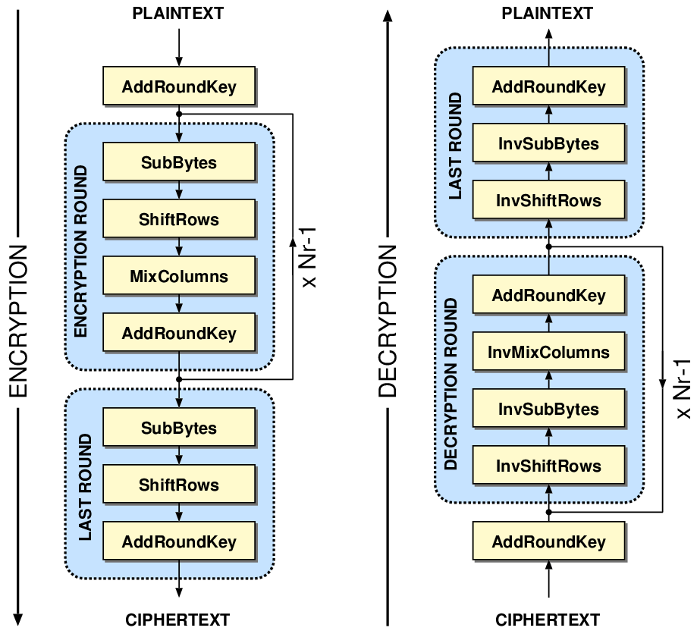
AES Algorithm
Notes:
Key Expansion process-
1)First 4 words are made up of cipher key
2)The rest of the words are made as follows
i mod 4 is not equals to 0
Wi = Wi-1 + Wi-4
3) i mod 4 is equals to 0
Wi = t+Wi-4
t is the temporary word
4)Subword(Rotword(Wi-1))+Rconi/4

Slide 8
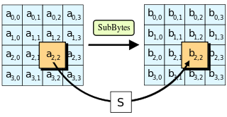
AES Description
KeyExpansions—round keys are derived from the cipher key using Rijndael’s key schedule. AES requires a separate 128-bit round key block for each round plus one more.
InitialRound
AddRoundKey—each byte of the state is combined with a block of the round key using bitwise xor.
Rounds
SubBytes—a non-linear substitution step where each byte is replaced with another according to a lookup table.
Notes:
1)To Substitute a byte ,we interpret the byte as 2 hexadecimal digits,the left digit determines the row and the right digit determines the column

Slide 9
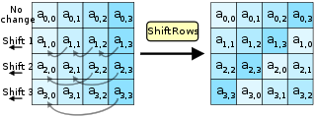
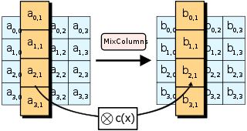
ShiftRows—a transposition step where the last three rows of the state are shifted cyclically a certain number of steps.
MixColumns—a mixing operation which operates on the columns of the state, combining the four bytes in each column.
Notes:
Advantages
Safe
Brute Force (128 Bit = 2¹²⁸ attempts)
Unbreakable, for now..
Disadvantages
Too simple algebraic structure

Slide 10
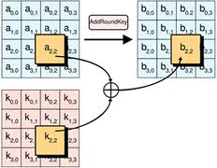
AddRoundKey
Final Round (no MixColumns)
SubBytes
ShiftRows
AddRoundKey.

Slide 11
LSB Algorithm for Steganography
2 steps of LSB technique:
Data Embedding:
Step 1: Extract the pixels of the cover image.
Step 2: Extract the characters of the text .
Step 3: Extract the characters from the Stego key.
Step 4: Choose first pixel and pick characters of the Stego key and place it in first component of pixel.
Step 5: Place some terminating symbol to indicate end of the key. 0 has been used as a terminating symbol in this algorithm.
11
Notes:
1. Least significant bit (LSB)
2. Pixel value differencing (PVD)
3. Edges based data embedding method (EBE)
4. Random pixel embedding method (RPE)
5. Mapping pixel to hidden data method
6. Labeling or connectivity method
7. Pixel intensity based method
8. Texture based method
Histogram shifting method
General advantages of spatial domain LSB technique are:
1. There is less chance for degradation of the original image.
2. More information can be stored in an image.
Disadvantages of LSB technique are:
1. Less robust, the hidden data can be lost with image manipulation.
2. Hidden data can be easily destroyed by simple attacks

Slide 12
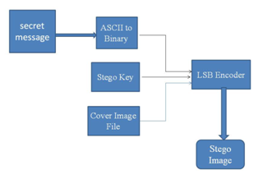
Step 6: Insert characters in first component of pixels by replacing it. Step 7: Repeat step 6 till all the characters has been embedded. Step 8: Again place some terminating symbol to indicate end of data. Step 9: Obtained stego image.
LSB Input Mechanism

Slide 13
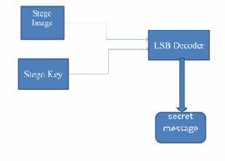
Data Extraction:
Step 1:Extract the pixels of the stego image.
Step 2:Now, start from first pixel and extract stego key characters from first component of the pixels.
Step 4:If this extracted key matches with the key entered by the receiver, then follow Step 5, otherwise terminate the program.
Step 5:If the key is correct, then go to next pixels and extract secret message characters from first component of next pixels.
Step 6: Extract secret message.
LSB Extraction Mechanism

Slide 14
Watermarking
Process
Embedding stage: In this stage, the image to be watermarked is preprocessed to prime it for embedding. This involves converting the image to the desired transform. This includes the discrete cosine transform (DCT), the discrete Fourier transform (DFT) and the wavelet domains.
Distribution stage: The watermarked image obtained above is then distributed through digital channels (on an Internet site). In the process, this may have undergone one of several mappings, such as compression, image manipulations that downsize the image, enhancements such as rotation, to name a few.

Slide 15
Extraction stage: In this stage, an attempt is made to regain the watermark or signature from the distributed watermarked image. This stage may need a private key or a shared public key, in combination with the original image, or just the watermarked image.
Decision stage: In this stage, the extracted watermark is compared with the original watermark to test for any discrepancies that might have occurred while distribution is being performed on the image.

Slide 16
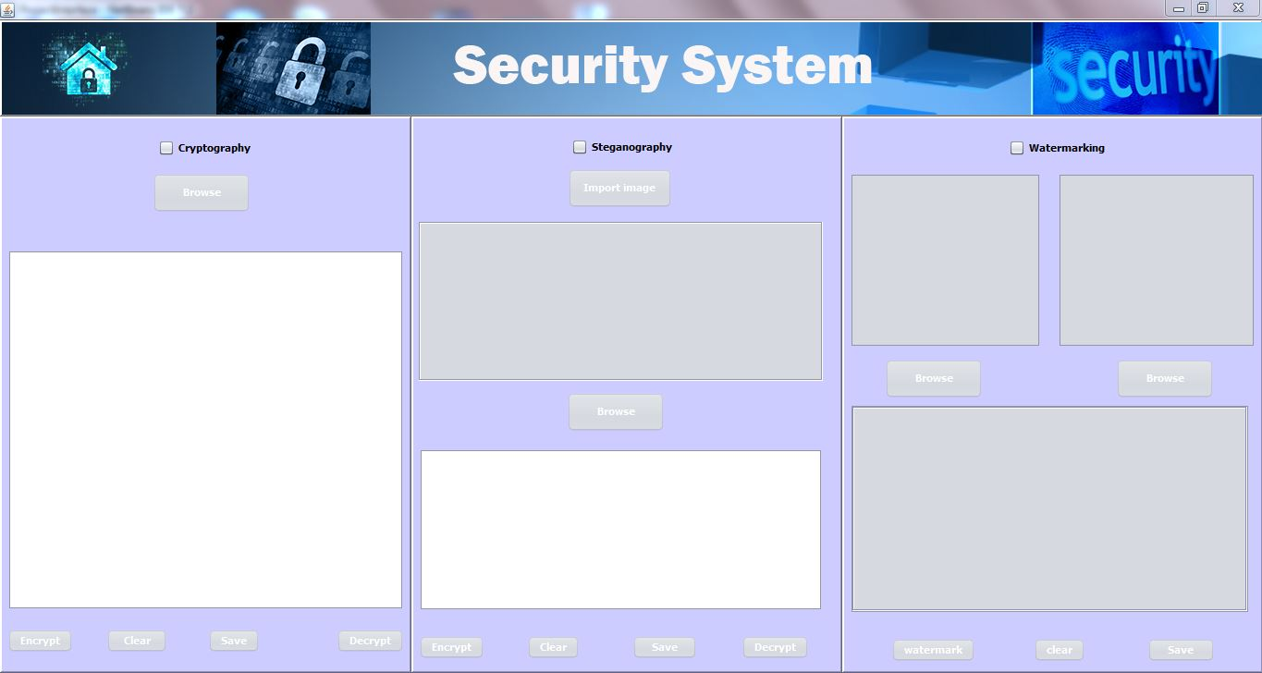
System Design

Slide 17
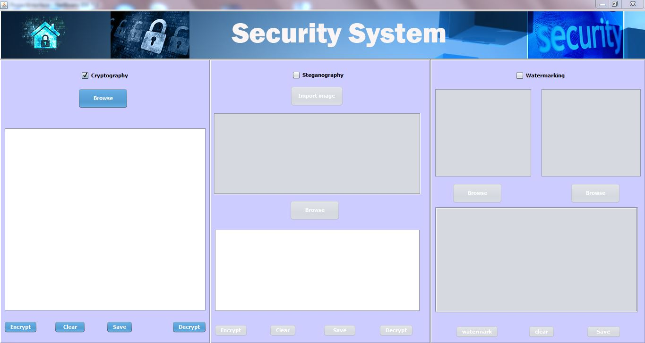
System Implementation
1).Choose Cryptography

Slide 18
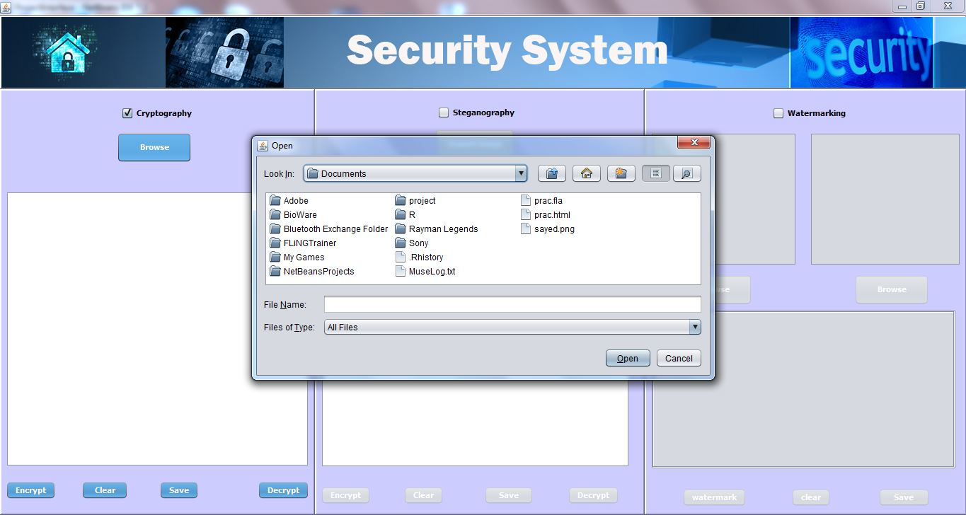
2).Browse the document.

Slide 19
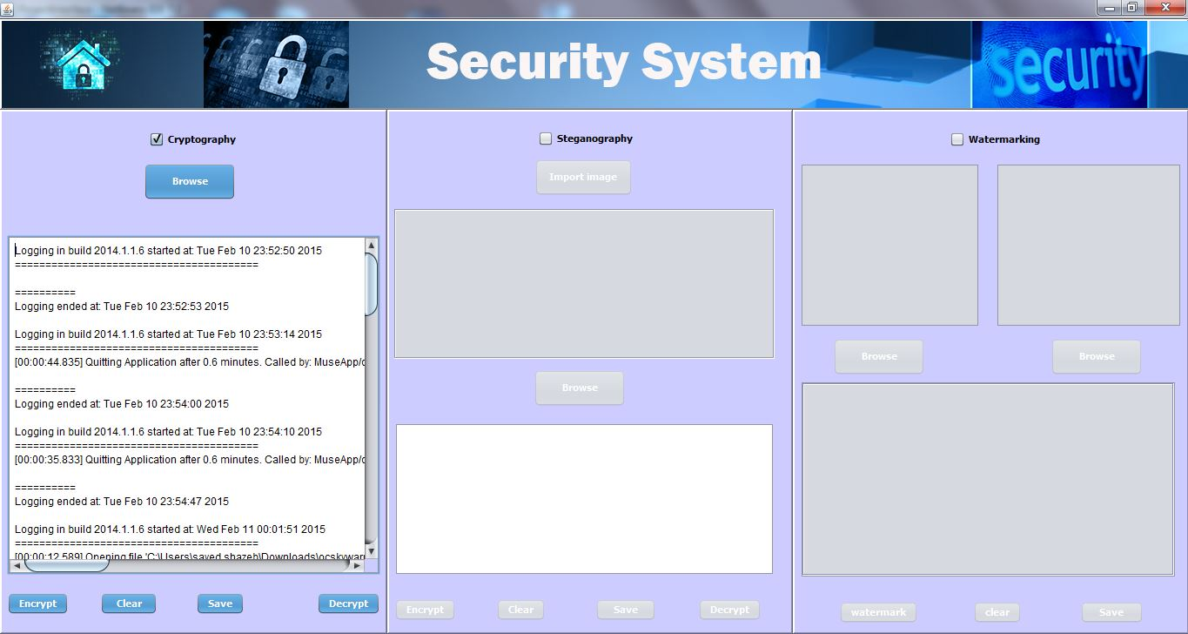
3).Encrypt the document.

Slide 20
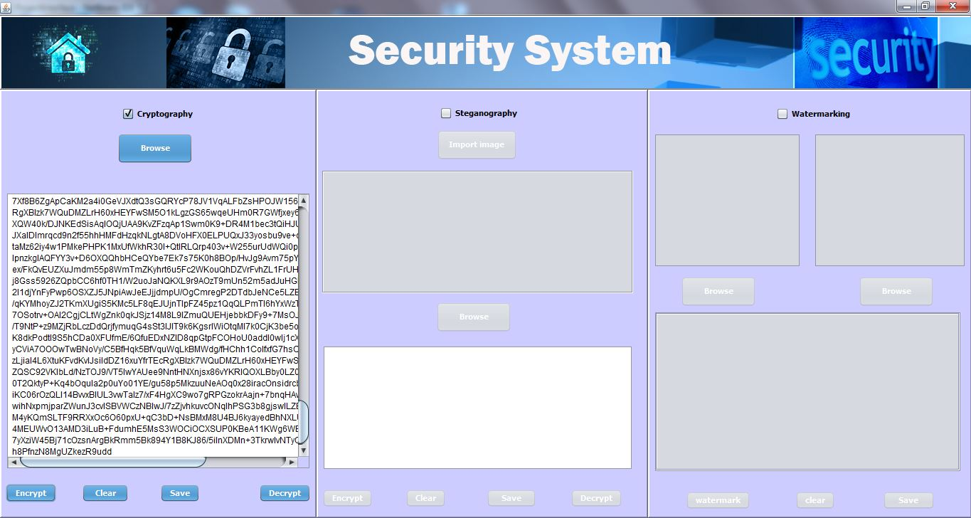
4).Encrypted document.

Slide 21
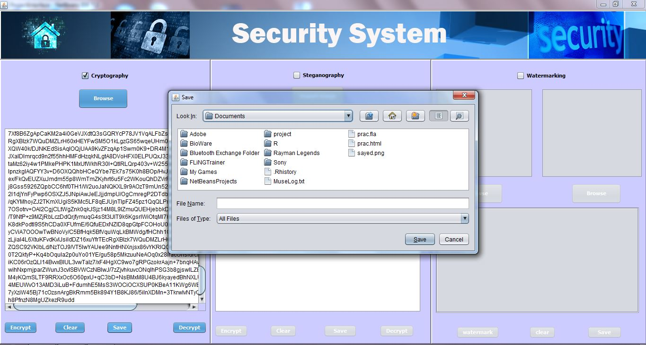
5.)Save encrypted document.

Slide 22
6).Decrypted document.

Slide 23
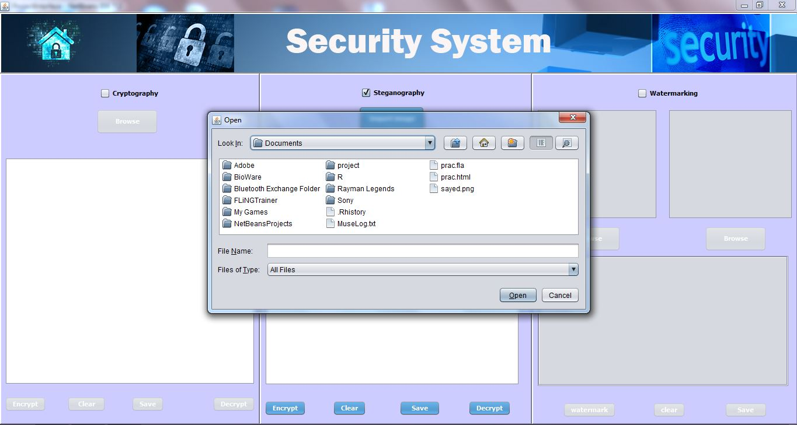
7).Browse image for steganography.

Slide 24

8.)Browse document to hide behind an image.

Slide 25
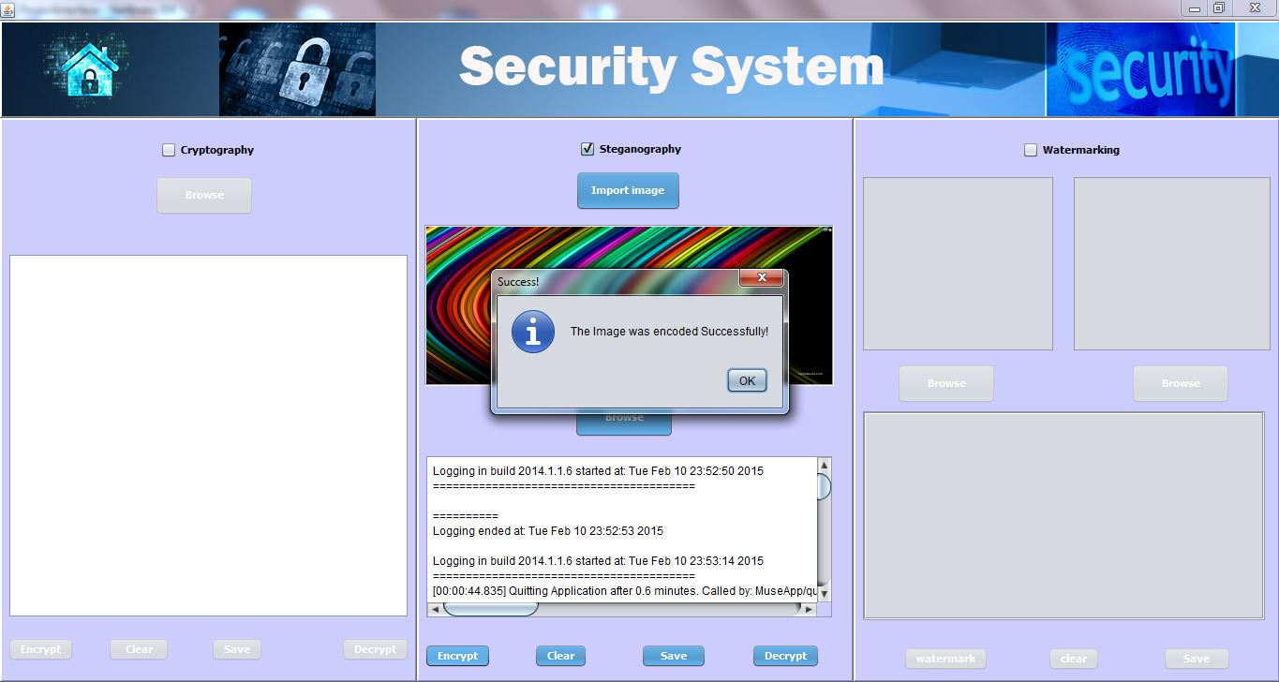
9.)Hide the data behind an image.

Slide 26
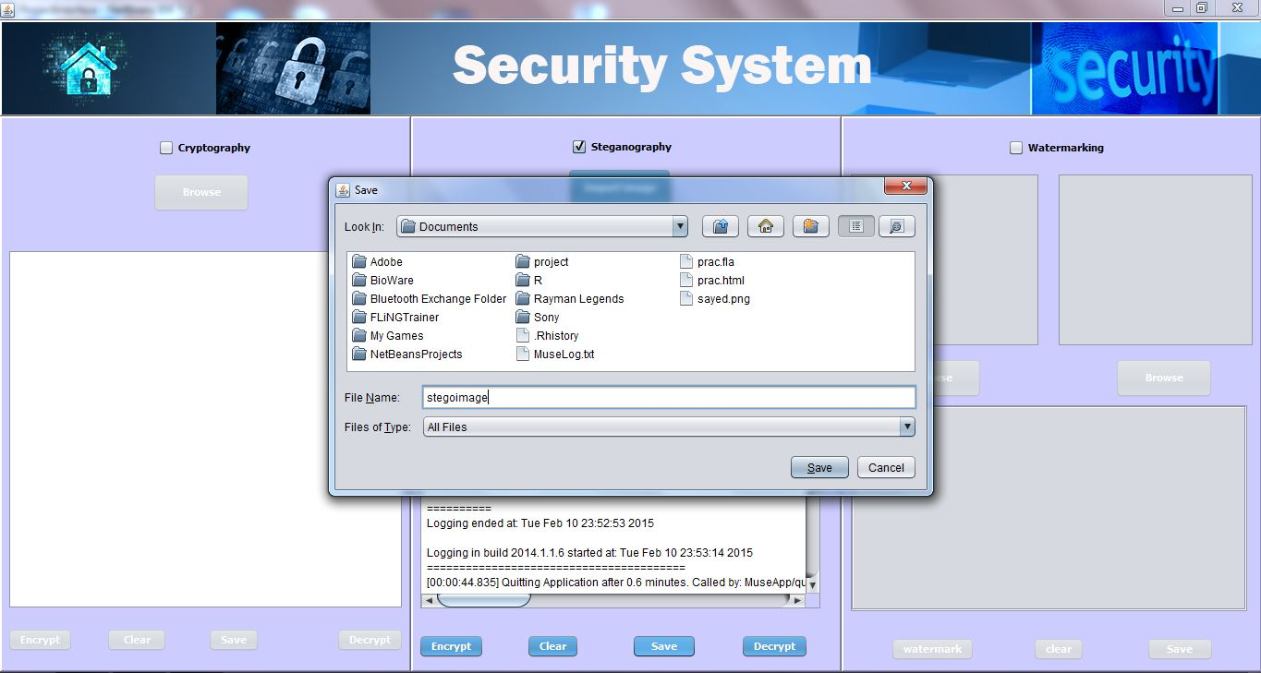
10.) Saving of image.

Slide 27
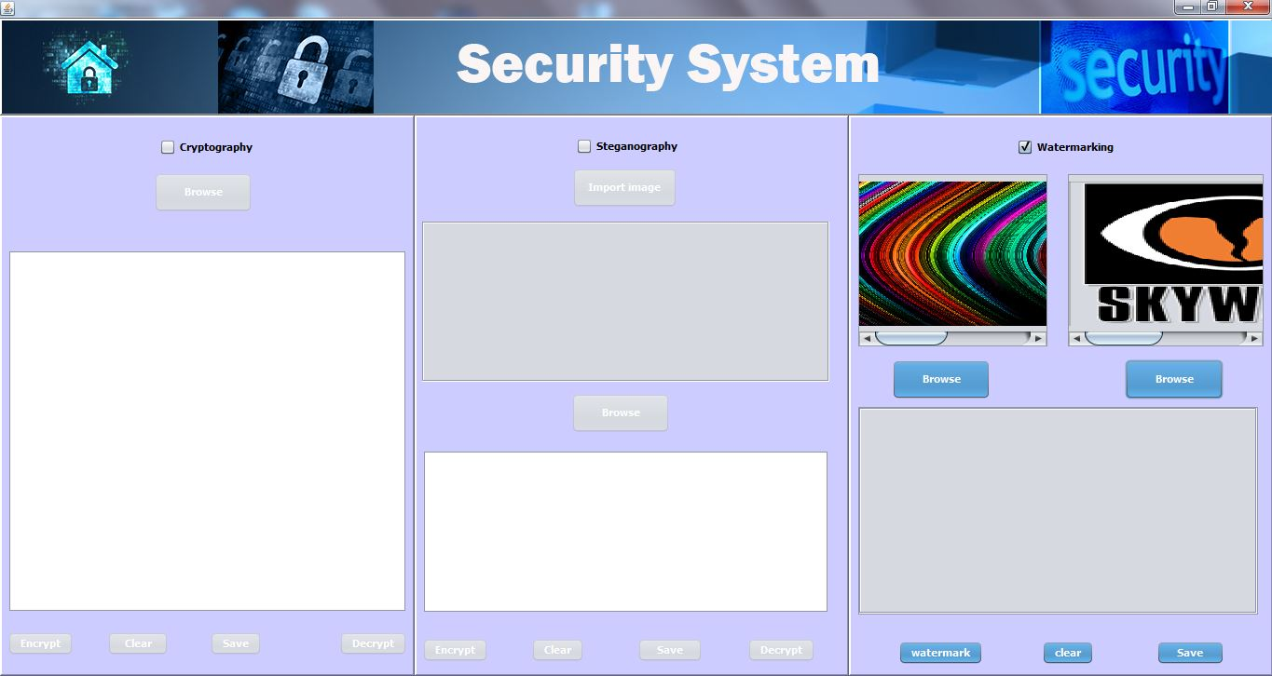
11.) Choose image for watermarking.

Slide 28
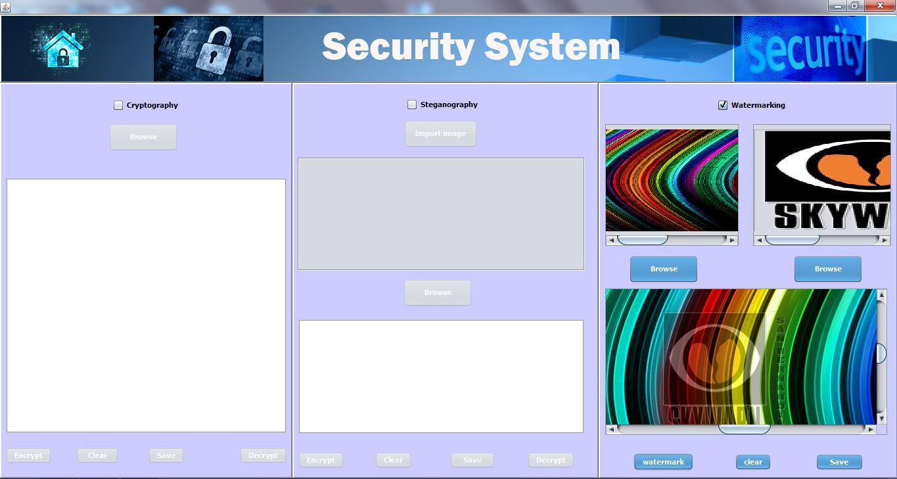
12.)Perform watermarking.

Slide 29
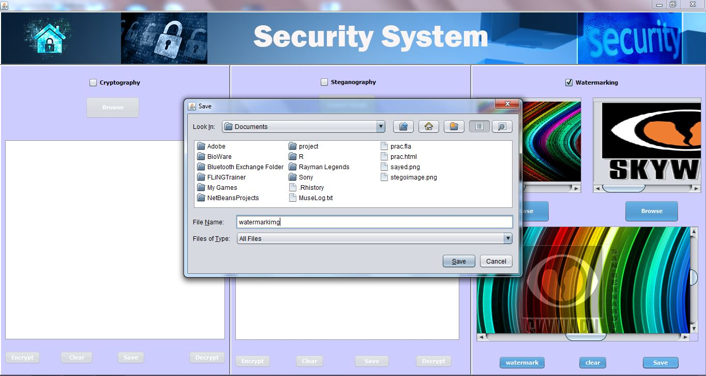
13.) Save watermarked image.

Slide 30
Conclusion
Steganography, especially combined with cryptography and watermarking is a powerful tool which enables people to keep their information secure without interruption of possible eavesdroppers and increase the level of security.
The main advantage of this System is to provide high security for sensitive information and providing three layer of security by addressing loss of integrity, loss of confidentiality and unauthorized sender.

Slide 31
Future Work
To implement AES 256 to provide more security for the data.
To implement audio and video steganography in the application .
To address Authentication problem in this application.
To remove watermark from an image.

Slide 32
References
[1]. B. P Fitzmann, “Trials of traced traitors.” Information hiding, first international work shop, Lecture notes in computer science R. Anderson, Ed. Berlin, Germany: Springer Verlag 1996, vol. 1, pp= 49-64.
[2]. K. Tanaka, Y. Nakamura and K. Matsui, “Embedding Secret Information in to a Dithered Multi Level Image,” in Proc IEEE Military communications conf., Monterey, CA, 1990, pp-
[3]. Neil F. Johnson and sushil Jajodia Exploring Steganography: seeing the unseen IEEE computer, 31(2) 26-34, 1998.

Slide 33
[4] Marvel, L.M., Boncelet Jr., C.G. & Retter, C., “Spread Spectrum Steganography”, IEEE Transactions on image processing, 8:08, 1999.
[5] M. Ramkumar & A.N. Akansu. “Some Design Issues For Robust Data hiding Systems”, http://citeseer.nj.nec.com/404009.html.
[6] N.F. Johnson, S. Jajodia, “Staganalysis: The Investigation of Hiding Information”, IEEE, pp. 113-116, 1998.
[7] Currie, D.L. & Irvine, C.E., (1996). Surmounting the effects of lossy compression on Steganography. 19th National Information Systems Security Conference.

Slide 34
[11] Naor .M and Pinkas .B (1997), “Visual authentication and identification,” in Proc. CRYPTO’97, vol. 1294, pp. 322–336, Springer-Vela LNCS.
[12] Nakajima .M and Yamaguchi .Y (2002), “Extended visual cryptography for natural images,” in Proc. WSCG Conference pp. 303–412.
[13] M.Naor and A.Shamir, “Visual Cryptography”, in Proceedings of Eurocrypt 1994, lecture notes in computer science, 1994, vol.950, pp. 1-12.
[14] Robert Ulichney, “The void-and-cluster method for dither array generation”, IS&T/SPIE Symposium on Electronic Imaging and Science, San Jose, CA, 1993, vol.1913, pp.332-343.

Slide 35
Annexure

